Slide 1
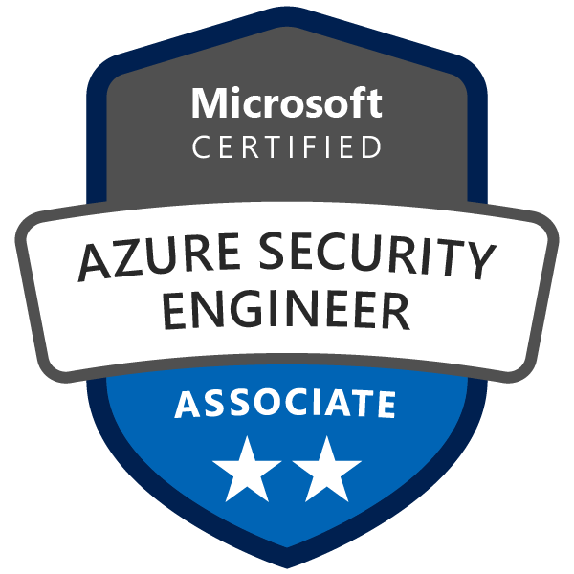
Exam AZ-500: Microsoft Azure Security Technologies Crash Course
Tim Warner

Slide 2


Tim Warner
Based in Nashville, TN, US
Central time zone
MCT, MVP
Twitter: @TechTrainerTim
Badge: TechTrainerTim.com

Slide 3
Course Materials
timw.info/az500

Slide 4
Session 1 of 2 Learning Goals
Introduction
Manage identity and access
Azure AD / Azure resource security
Implement platform protection
Key Vault
Networking

Slide 5
Session 2 of 2 Learning Goals
More platform security
VMs
Containers
App Service
Manage security operations
Configure Azure Security Center
Secure data and applications
Storage accounts
Databases

Slide 6
A Different Kind of Training
Let's avoid slide show fatigue
We'll learn by doing – at least 80 percent demo
Case study/scenario approach
5-minute break at midpoint
I’m here to answer your questions – take advantage of this!
Use the Q&A panel

Slide 7

Session Recordings

Slide 8
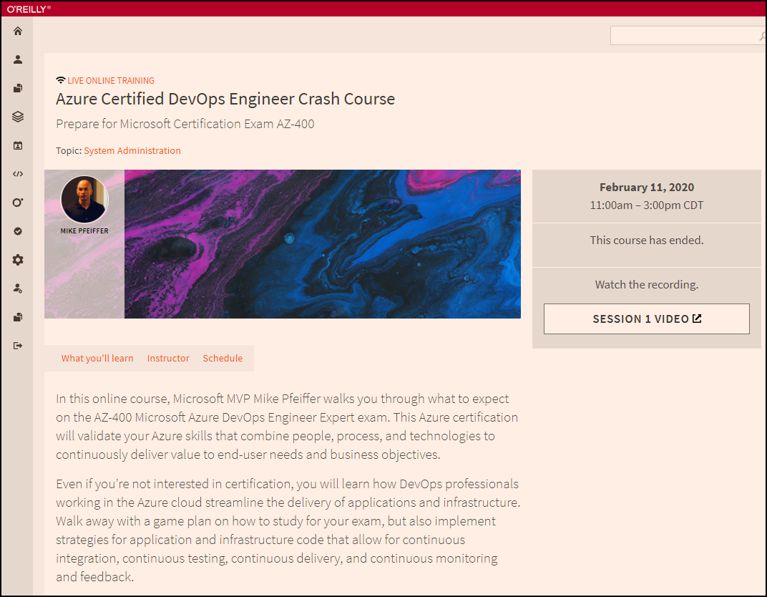
Session Recordings

Slide 9

Session Recordings

Slide 10
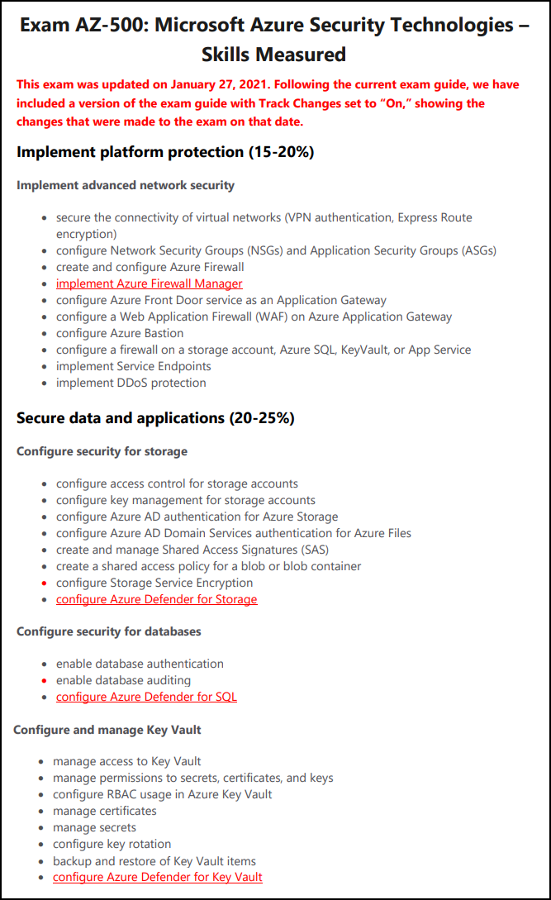
AZ-500 Changes: January 27, 2021

Slide 11
Tim's Certification Study Pyramid
Interdependence
Content knowledge
Practical application
Test-taking skills

Slide 12
Manage Identity and Access

Slide 13

Tenant vs. Subscription

Slide 14

Hybrid Identity

Slide 15

Passthrough Authentication

Slide 16

Seamless Single Sign-On

Slide 17
Seamless Single Sign-on

Slide 18

Azure Management Scopes
/ Tenant Root

Slide 19


Azure AD and Subscriptions

Slide 20
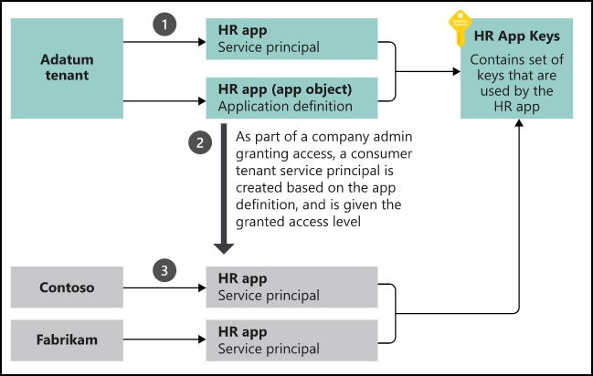
App registrations and service principals

Slide 21

Azure AD B2C

Slide 22

Azure AD Domain Services

Slide 23
Azure AD SSO

Slide 24
Passthrough Authentication

Slide 25

AD FS Federation

Slide 26
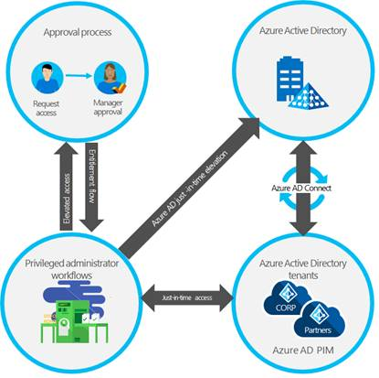
Azure AD PIM

Slide 27
Implement Platform Protection

Slide 28
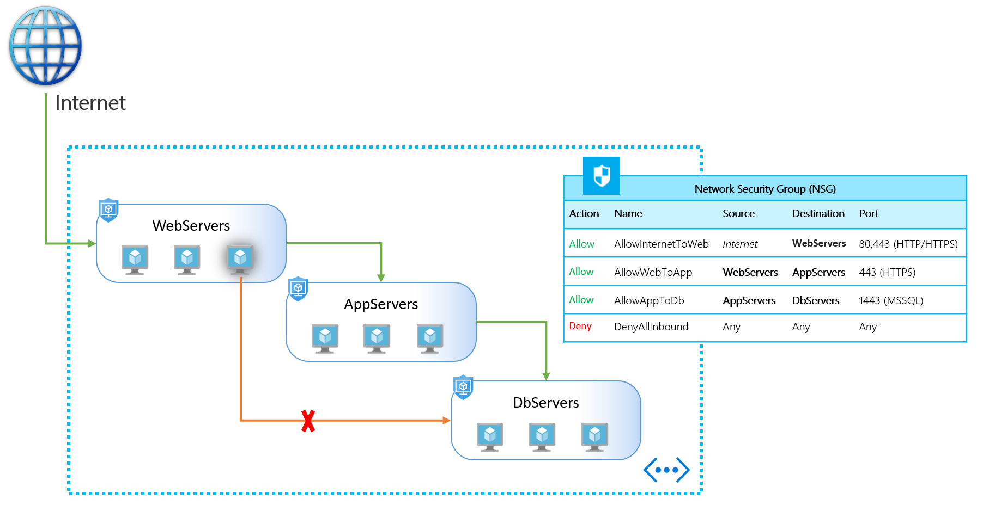
NSGs and ASGs

Slide 29

VM High Availability

Slide 30

Web App High Availability

Slide 31
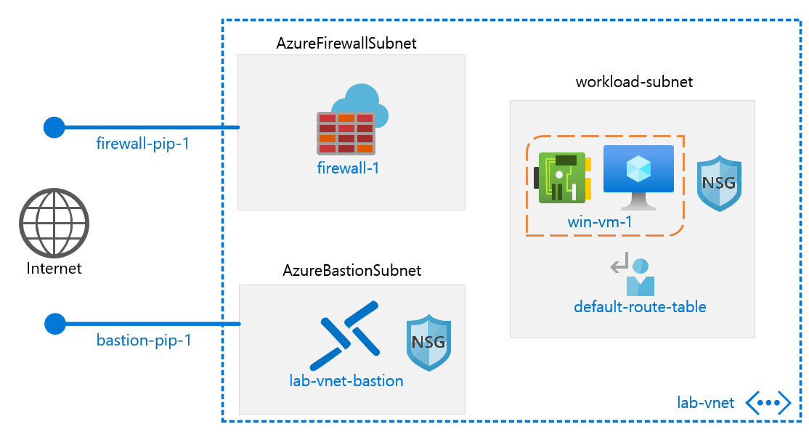
Azure Firewall

Slide 32
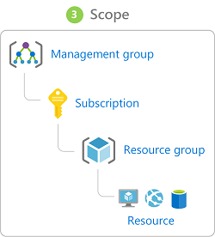
Azure Management Scopes
/ Tenant Root

Slide 33

Service endpoints

Slide 34
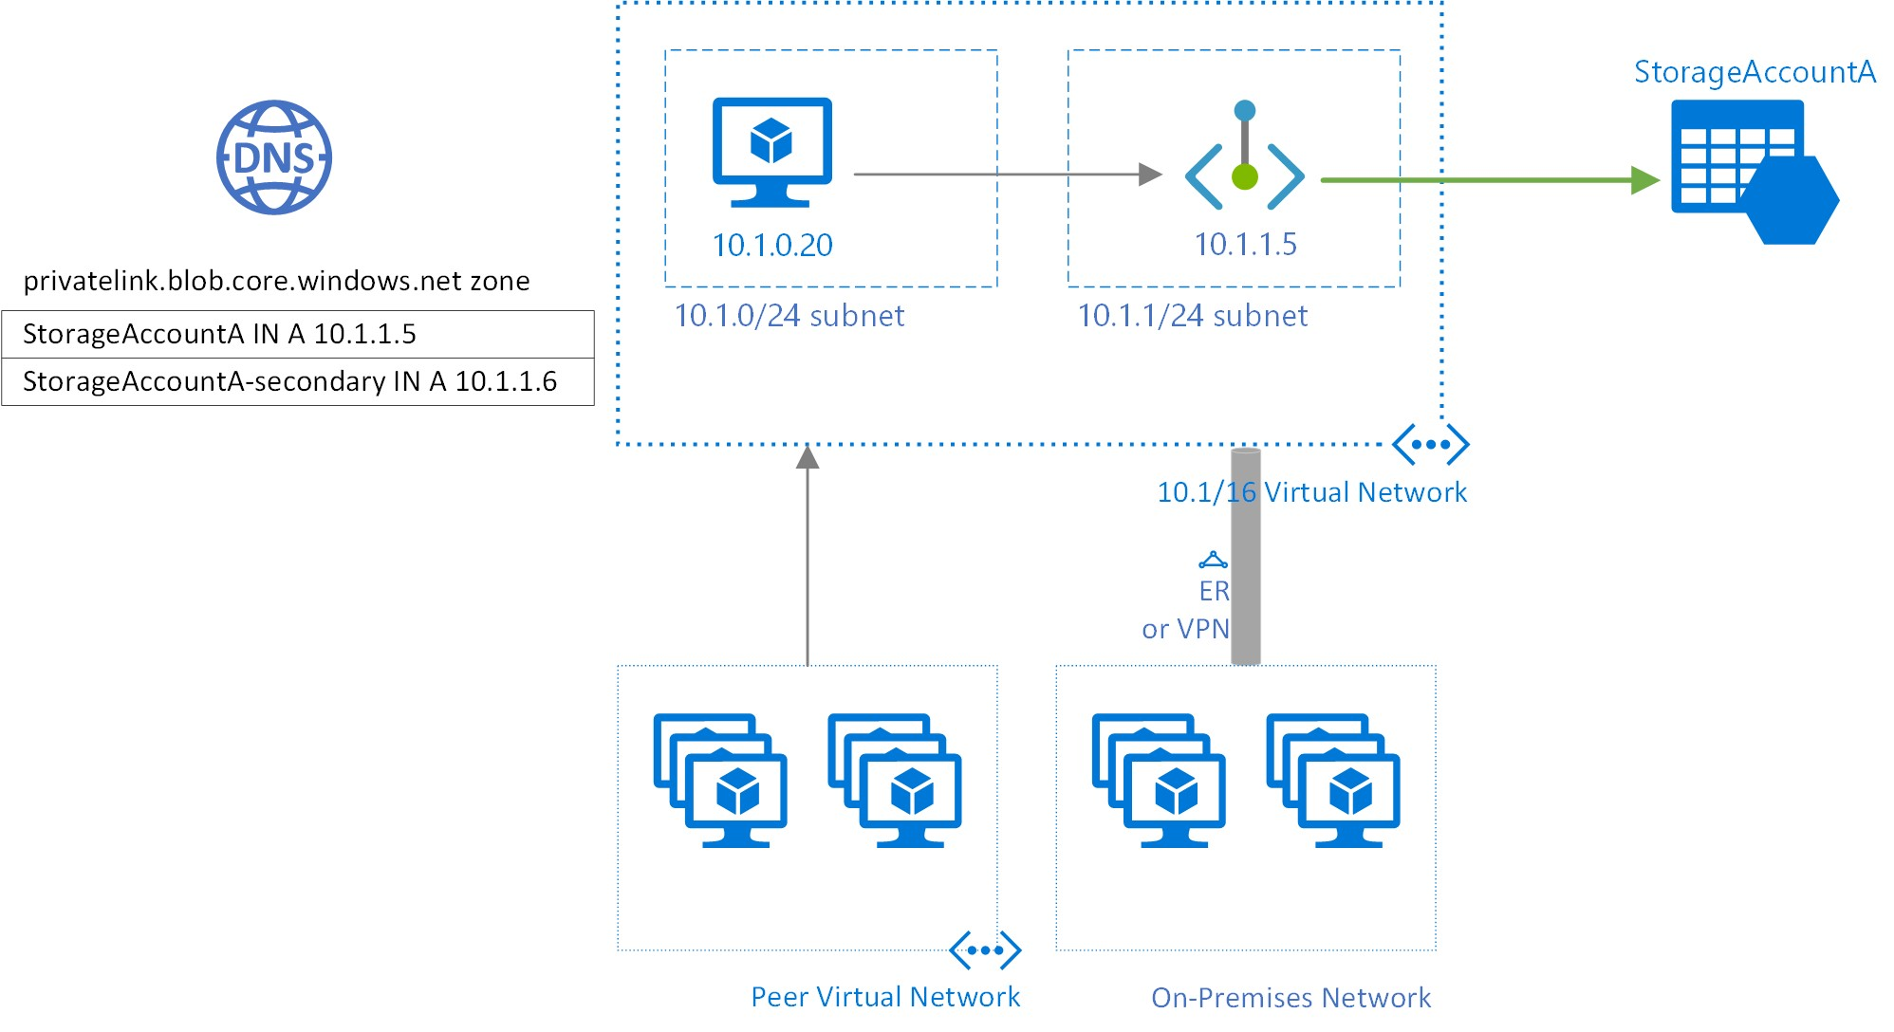
Private endpoints

Slide 35
Manage Security Operations

Slide 36
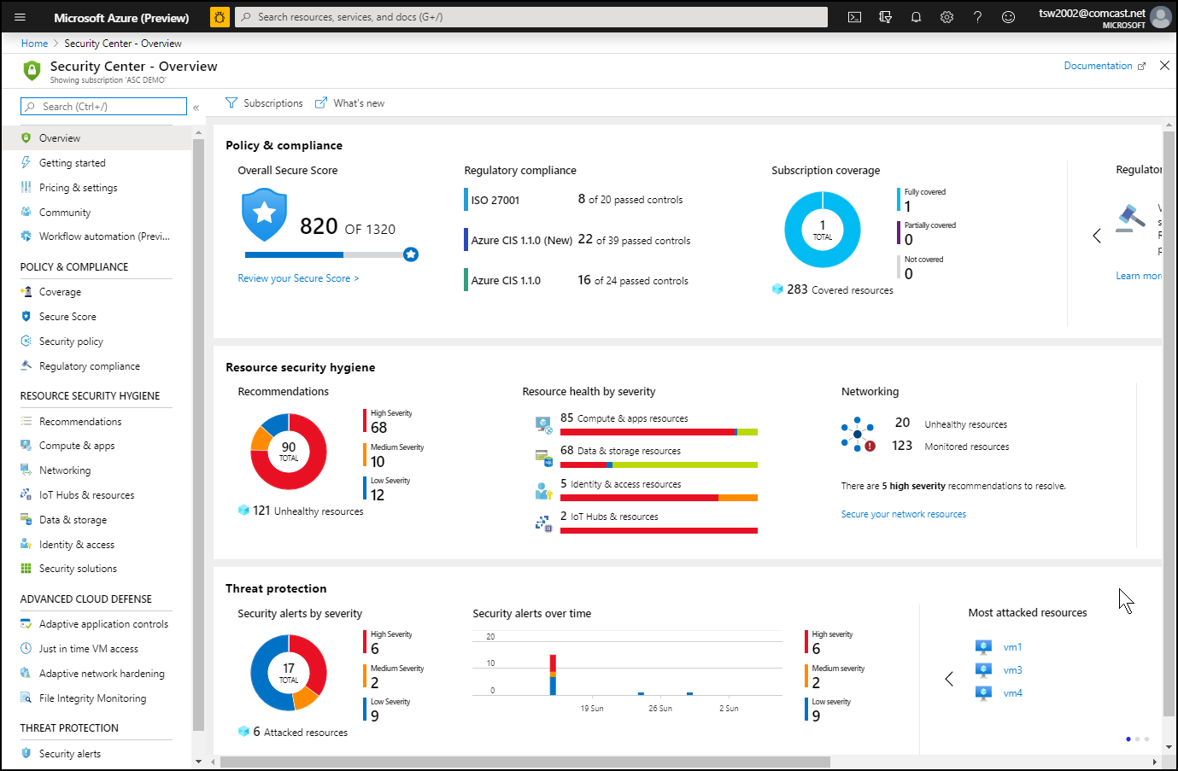
Azure Security Center

Slide 37
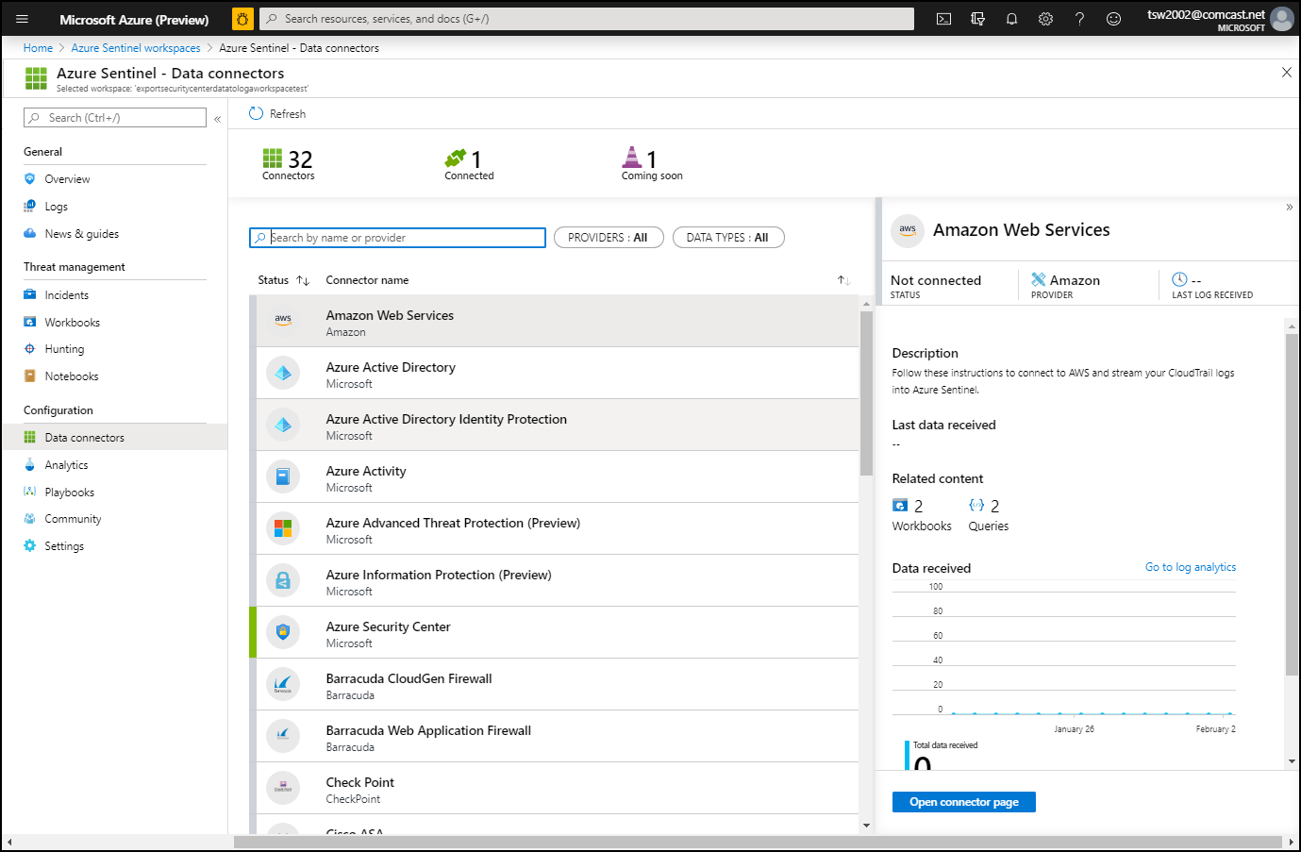
Azure Sentinel

Slide 38
Secure Data and Applications

Slide 39
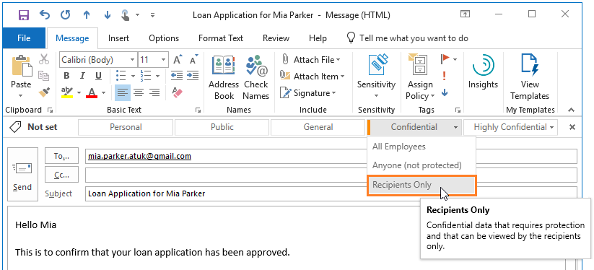
Azure Information Protection

Slide 40
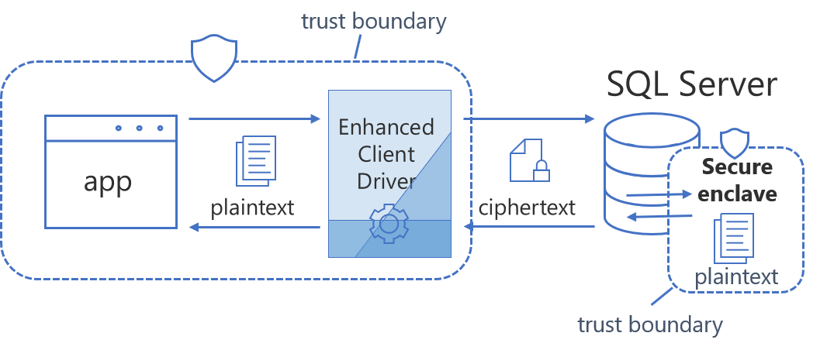
Always Encrypted

Slide 41
Exam AZ-500 Item Types

Slide 42

Single Answer Multiple Choice

Slide 43

Multiple Answer Multiple Choice

Slide 44
Repeated Scenario
You need to move an Azure VM to another hardware host.
Solution: You redeploy the VM.
Does this solution meet the goal?
Yes
No

Slide 45
Repeated Scenario
You need to move an Azure VM to another hardware host.
Solution: You enable boot diagnostics.
Does this solution meet the goal?
Yes
No

Slide 46

Select and Place

Slide 47

Build List and Reorder

Slide 48

Active Screen/Fill in the Blank

Slide 49

Case Study

Slide 50






Performance-Based Lab

Slide 51
Microsoft Online Testing

Slide 52
Microsoft Online Testing Process
timw.info/online

Slide 53

Microsoft Online Testing Process

Slide 54

Microsoft Online Testing Process

Slide 55

Microsoft Online Testing Process

Slide 56

Microsoft Online Testing Process

Slide 57

Microsoft Online Testing Process

Slide 58

Microsoft Online Testing Process

Slide 59

Microsoft Online Testing Process

Slide 60
AZ-500 Exam Strategy
Focus your skills accordingly:
60 percent Azure portal
20 percent Azure PowerShell
10 percent Azure CLI
10 percent KQL
Azure AD PIM all day long
Expect performance-based labs, but be happy if you don't see 'em

Slide 61
Parting Advice
Check out my YouTube (timw.info)
Online testing
Cert item strategy
AZ-500 study guide
Invest in Whizlabs or MeasureUp
Register for your exam ASAP!

Slide 62
Thank you!
Course materials: timw.info/az500
Twitter: @TechTrainerTim
Work: timw.info/ps
Web: TechTrainerTim.com

